Slide 1

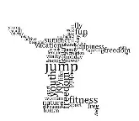
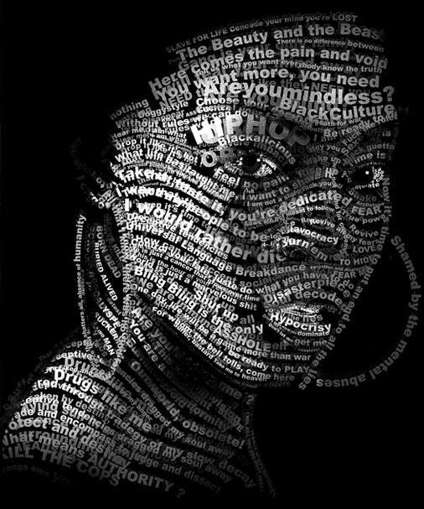
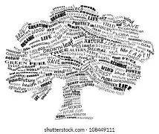
M2 - Day 1 L&L Fest Ekphrastic poetry
Ekphrastic poetry means a poem written about a work of art (like a painting, sculpture, or photograph).
The poet describes the artwork in words and often reflects on its meaning, beauty, or the feelings it creates.

Slide 2
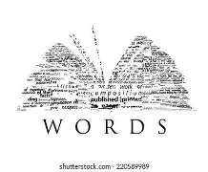















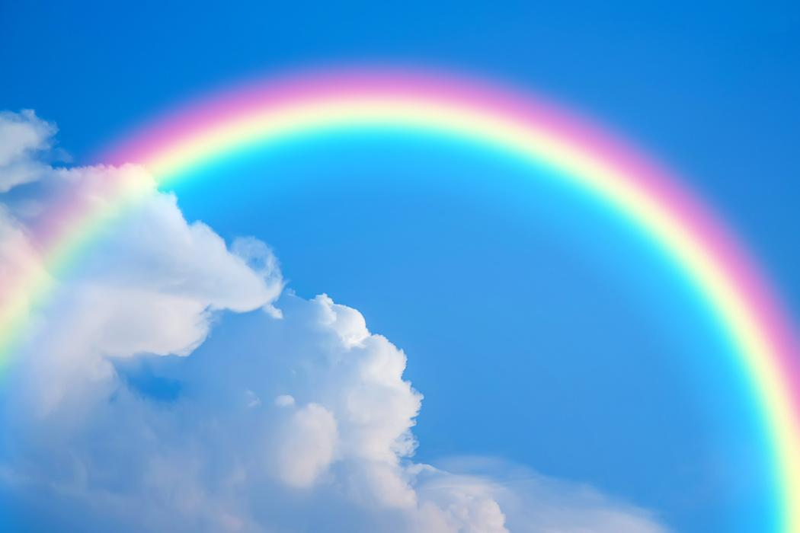
I.Draw a word art using words from any of the given 5 options.
1
5
Artificial
Intelligence
Pattern
Nationality
Soldier
surroundings
Territory
Identity
Automatic
Robotics
Network
Technology
Development
WORD
ART
Artists
2
Space
4
Rainbow
Galaxies
Orbit
Asteroids
Rocket
Astronaut
Clouds
Sunlight
Thunder
Sky
Rainfall
3
Kingdom
King
monarch
Emperor
Noble
Dynasty

